Slide 1
EMERGENCY MANAGEMENT
Projects:
Australian Bushfires & Ambulance

Slide 2
Project Overview
Ambulance :
The project is about performing data analysis on Road Accidents data, Ambulance Victoria data and finding the correlation between characteristics of the local populations(age groups, gender), ambulance services used and the weather conditions.
Bushfire:
To cluster bushfire prone areas and to understand what areas in the future are more prone to bushfire.
We are developing an appropriate website using the required tools.

Slide 3
Deliverables of the Overall Project
Main deliverable: Predictions on fire prone areas and completing the ambulance data project
Support:
Task | Member | Technologies
Data sourcing | Nithin, Mohan, Nikhil Reddy, Nikita , Bala, Varsha, Vijay | Various websites
Data Cleaning | Nithin, Bala Tharun | Python
Data visualisation | Pavan, Mohan, Aiswarya, Nikhil Reddy, Hamza, Piyush Gandhi | Tableau, Python
Developing UI | Pavan, Simran, Nikita, Varsha | Html, css

Slide 4
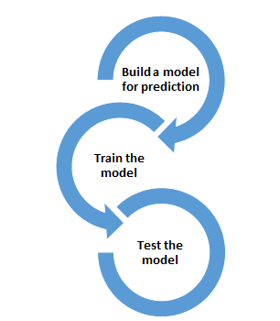


Visualization
Creating website
Data sourcing
Data cleaning
Methodology/Process

Slide 5
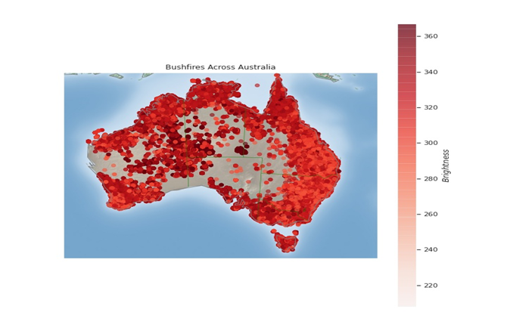
Goals Acquired
This graph shows the total number of bushfire cases across Australia. The fires have different levels of intensity which is demonstrated by the color map.

Slide 6
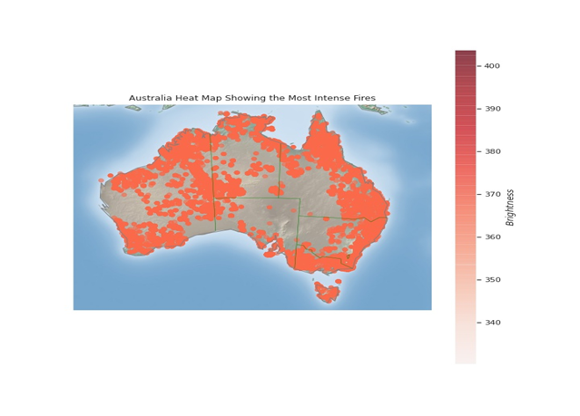
This heat map explains the places in Australia which have experienced the most intense fires.

Slide 7
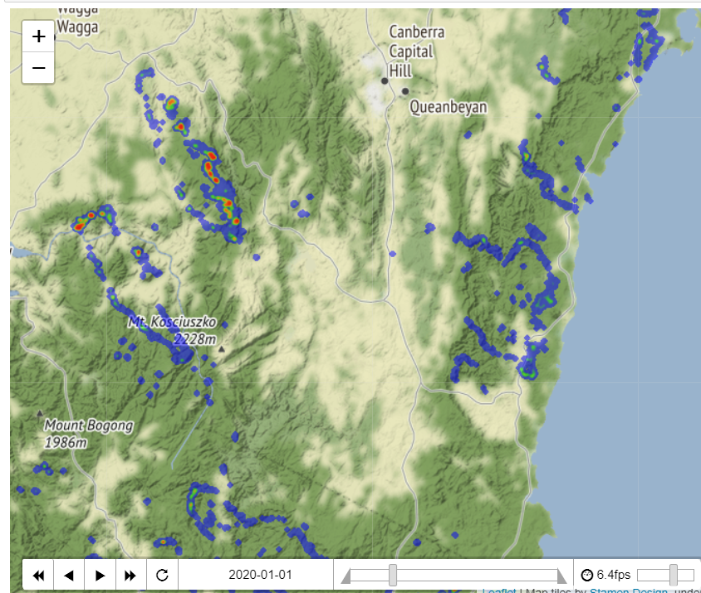
Canberra time series visualization:
The picture is one of the samples which we got by analyzing the real-time data using latitude and longitude and the fire radiation per day.

Slide 8
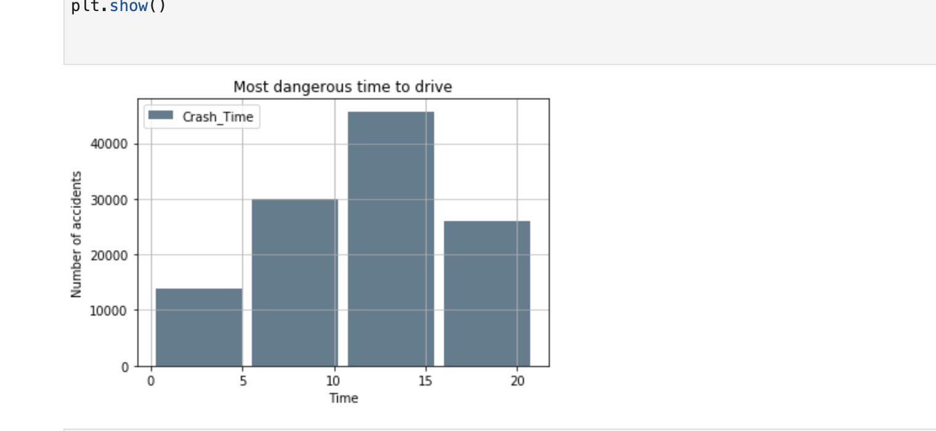
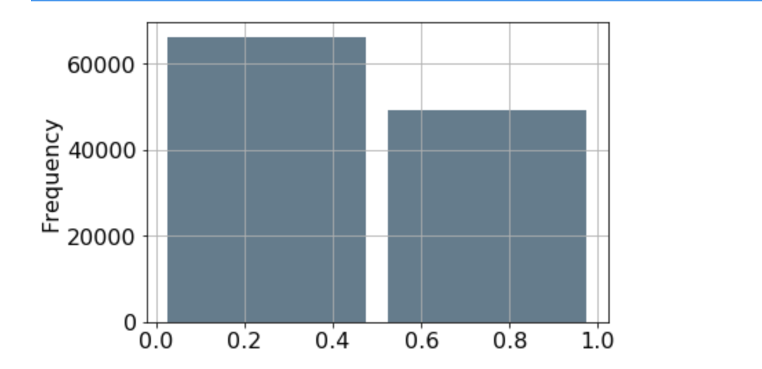
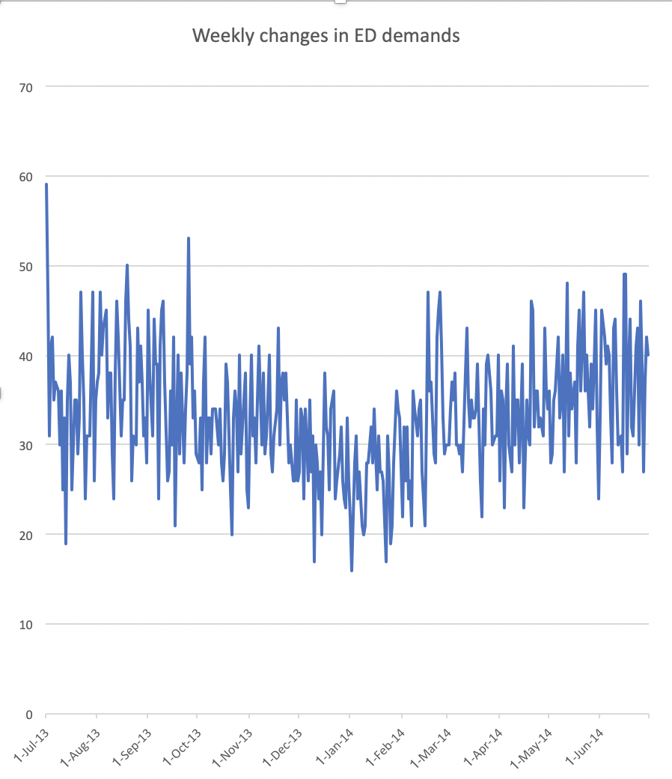
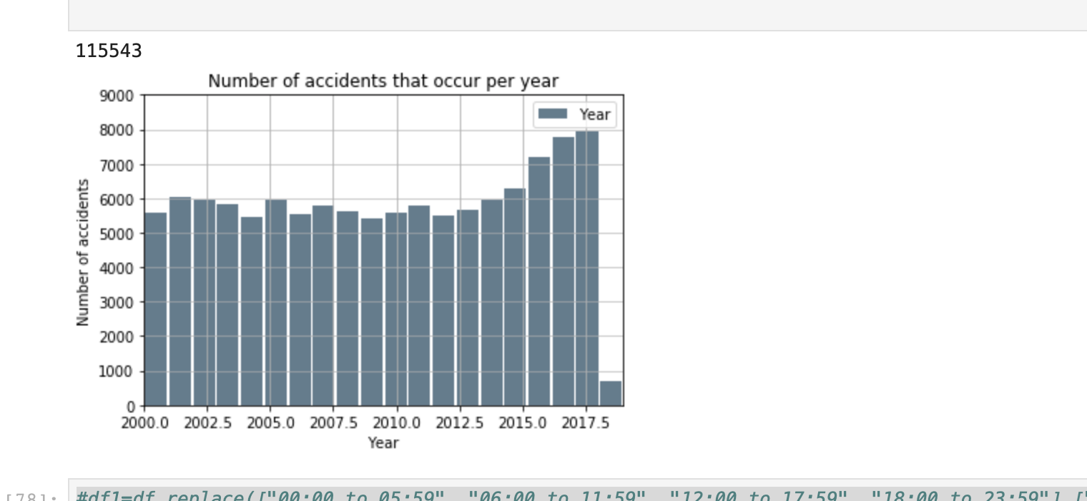
Ambulance Victoria Data Visualization Graph
Most dangerous time to drive
Number of Accidents based . on Gender shows that Male drivers have caused more accidents I.e. around 68000 whereas female drivers were responsible for around 50000 accidents overall.
We analyzed that 10 AM to 3 PM was the most dangerous time to drive.
The number of Accidents have gradually increased over the years, with 2017 having the maximum accidents.
Weekly changes in ED demand state that Jul 13 had the maximum demand.
Number of Accidents based on Gender
Weekly changes in ED demands
Number of Accidents per year

Slide 9
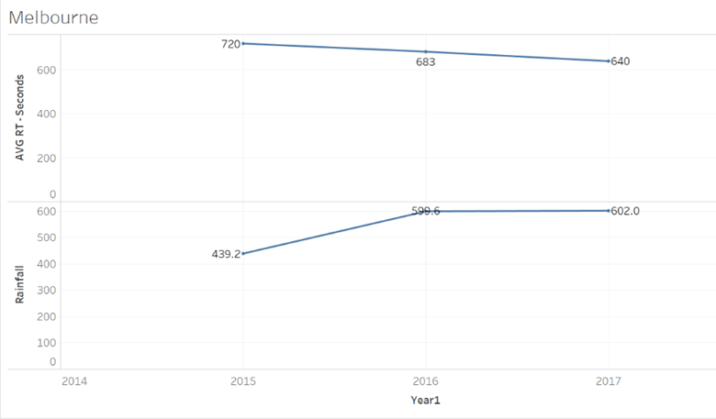
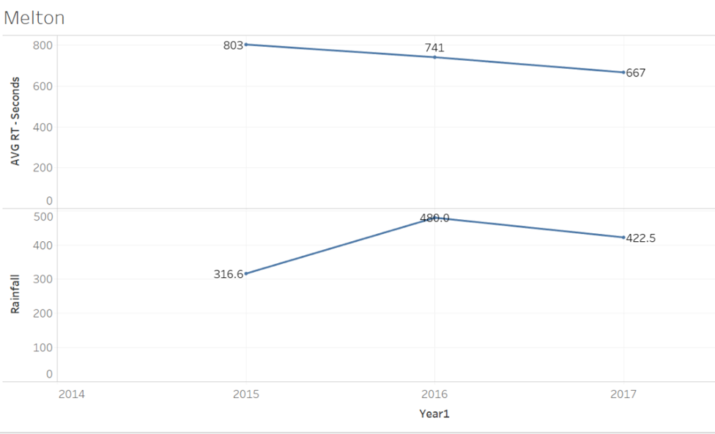
AVG Response time Vs Annual Rainfall data

Slide 10
Team Contribution
Team Member | Major Contribution(s) | Hours Recorded
Pavan Vadla | Data Sourcing, Visualization of Ambulance Victoria Data, Predicting future Emergency Requirements and final documentation. | 50
Nikita Shishupal Dighe | Mentoring and Managing, Distribution of tasks, Data Sourcing, Preparing User Interface, Planning and execution of UI, Presenting the presentation | 57
Aiswaraya Subrahmanian | Data sourcing for bushfire and weather data. Created heat maps for data. Did reverse geocoding for the bushfire data. | 55
Vijay bathini | Data souring, making presentations and Data Cleaning | 50
Bala Tharun Reddy Shymala | Data Sourcing for Bushfire, Data Cleaning, extraction of weather data in respective with the bushfire locations | 52
Simran Rashpal Dhillon | Planning of UI design, Wireframe representation, Implementation and Execution of UI | 42.5
Varsha Shankar | Data Sourcing, planning to conribute in UI design and final documentation | 45

Slide 11
Team Member | Majort Contributions | Hours Recorded
Mohan Kiran Bandaru | Visualization using Tableau and Python( time series for Canberra) Data sourcing for bushfire locations Documentation and it is showcased in folder "Mohan" | 41.5
Hamza Zulfiqar | Data extraction for the bushfires, got familiar with python for my part in Iteration 2, learnt how to plot graphs and visualize data in python | 25.3
Shikhar Dhyani | Data sourcing, documentation of presentations, upskilling in python, using python to create graphs for data analysis in iteration 2 | 35.3
Piyush Gandhi | Data Sourcing, Analysis and Visualization of Ambulance Victoria Data, Predicting future Emergency Requirements. | 55
Nithin Reddy Gundre | Data Sourcing, Extracting weather data, Visualisation, Documentation of UI (prototype) | 39
Nikhil Reddy Viraati | Data Sourcing, Data visualization, Working on the previous year's project Ambulance Data, Extracting Weather data relevant to the Bushfire Data. | 48

Slide 12
Plan for the next iteration
Finalizing our Ambulance project:
Completing the visualization and final report of our project.
Predicting bushfire prone areas:
Finalizing the user interface and start working on developing the website.
Start building models for predicting bushfire prone areas.

